Slide 1
Session II. How does a machine learn?
Introduction to Neural Network
Presenter: Marco Merens (Chief/IAA)

Slide 2
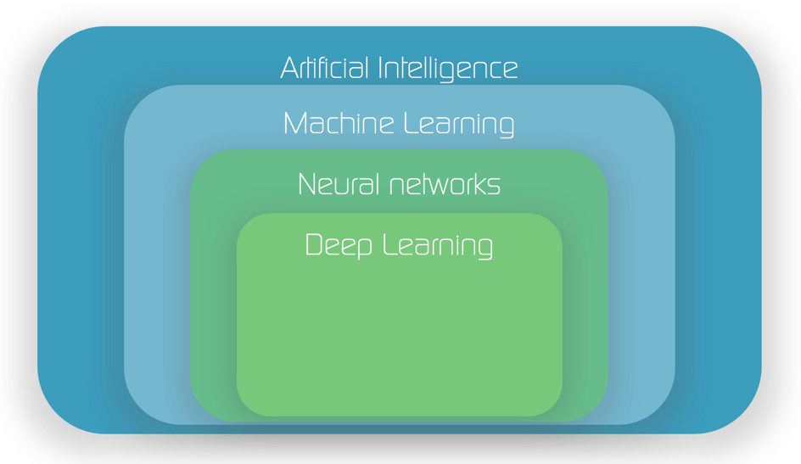
What is Neural Network(NN)?

Slide 3
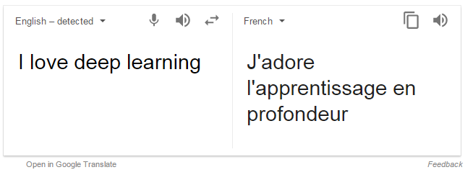
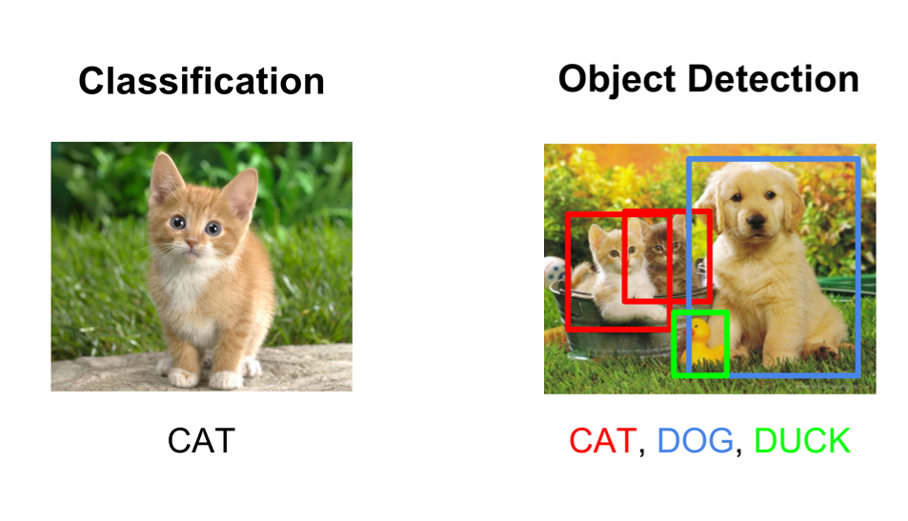
What is Neural Network(NN)?
One of the most successful model in Machine Learning.
Computer Vision
Face Recognition
Speech Recognition
Machine Translation
Vehicle Control
E-Mail Filtering
Medical Diagnosis
Automated Trading System…

Slide 4
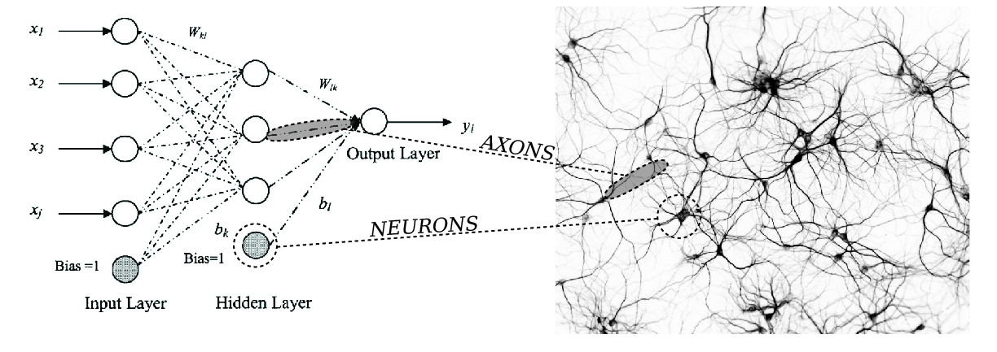
What is Neural Network(NN)?
Artificial Neural Network
Biological Neural Network

Slide 5
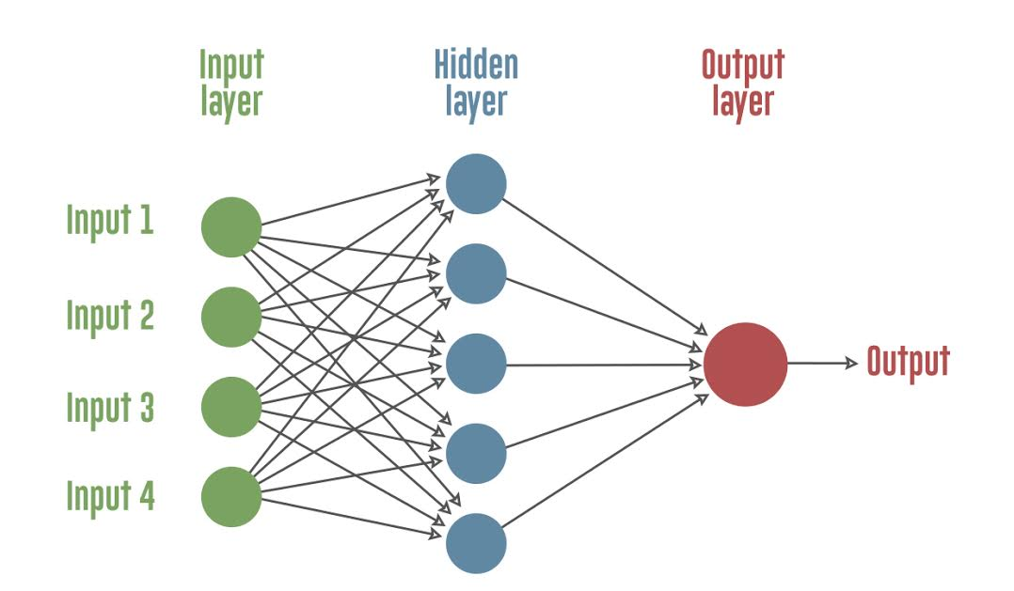
What is Neural Network(NN)?
→ Overview of Artificial Neural Network
Network with nodes and links.
Each circle represents neuron, and an arrow represents a connection of output of one neuron to the input of another neuron at next layer.
The machine captures the pattern of the data and record into the connections, or weights.

Slide 6

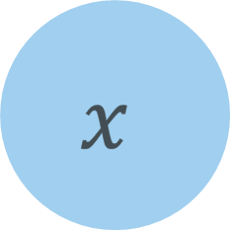
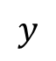
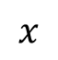

How Neural Network Works?
→ Each node has linear function between its input and output.
1 x 1 Node
$$y$$
Linear Function
$$x$$
$$y$$
w
High w
weight
Input
Output
Low w
$$y=w∙x$$
$$x$$

Slide 7
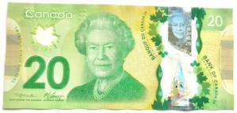

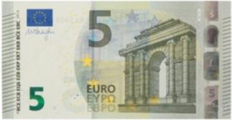


Linear Regression: Currency Exchange
How much is the exchange rate between CAD to EUR?
Exchange Rate
40 CAD
25 EUR
What if the rate is dynamic?
$$x$$
w
$$y$$
weight
Input
Output

Slide 8

Linear Regression: Currency Exchange
Let’s guess exchange rate (weight) from 3 data points.
Currency Exchange Deals
There is no w that perfectly matches all of those equation!!
Not all deals had a same exchange rate!
Data | CAD | EUR
#1 | 40 | 25
#2 | 50 | 35
#3 | 80 | 50
$$EUR=exchange rate×CAD$$
$$25=w×40$$
$$35=w×50$$
$$50=w×80$$

Slide 9
Regression Problem
Let’s find the best exchange rate that fits well (but not perfectly) for every data points.
The weight here can be represented as “trendline”.
Finding the best linear “trendline” is the Linear Regression Problem.
Exchange Rate?

Slide 10
w
Predictions
Predictions & Errors
First, we guess initial exchange rate and draw the line.
We make a prediction of how each CAD would be exchanged into EUR according to our guess. (Prediction)
The errors shows how bad the predictions are. Our goal is to minimize the errors!
80 x w
errors
50 x w
40 x w

Slide 11
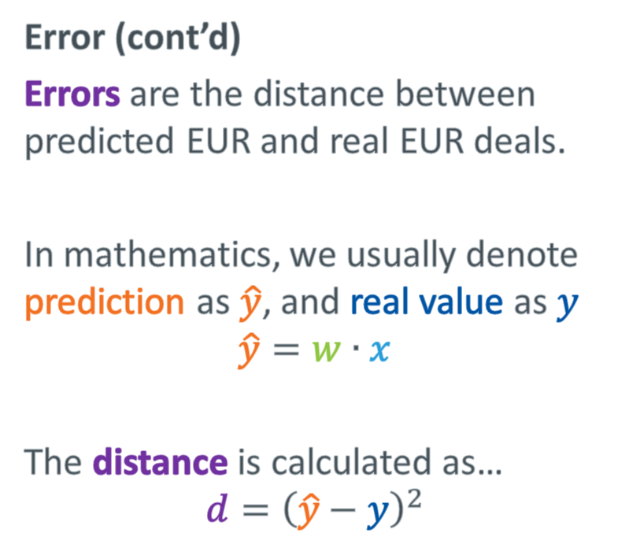
w
Error (cont’d)
Errors are the distance between predicted EUR and real EUR deals.
In mathematics, we usually denote prediction as $\hat{y}$, and real value as $y$
$$\hat{y}=w∙x$$
The distance is calculated as…
$$d={\left(\hat{y}−y\right)}^{2}$$
80 x w
errors
50 x w
40 x w

Slide 12
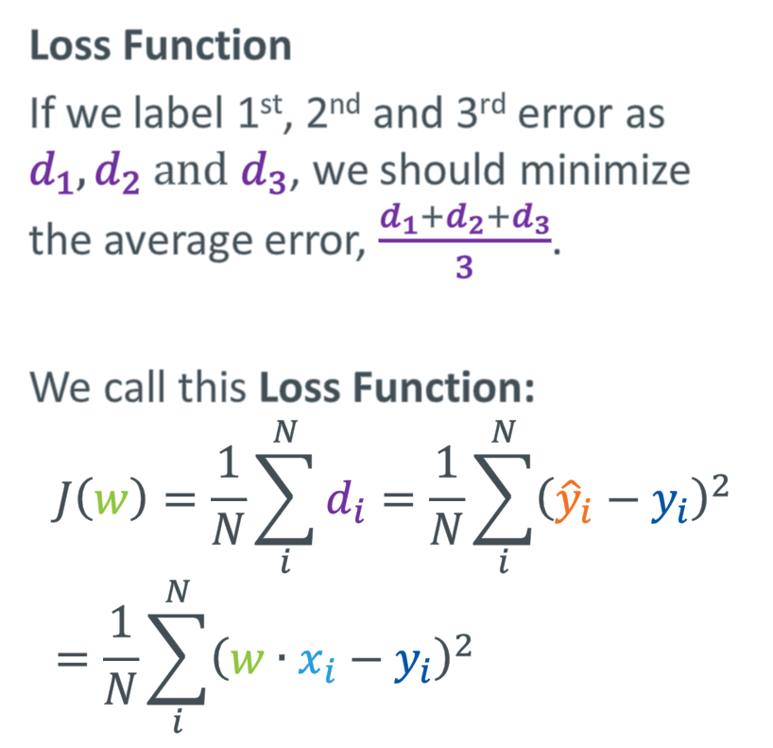
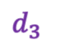
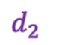
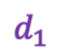
w
Loss Function
If we label 1st, 2nd and 3rd error as $d_{1}, d_{2} and d_{3}$, we should minimize the average error, $\frac{d_{1}+d_{2}+d_{3}}{3}$.
We call this Loss Function:
$$J\left(w\right)=\frac{1}{N}\sum_{i}^{N}{d_{i}=\frac{1}{N}\sum_{i}^{N}{{\left({\hat{y}}_{i}−y_{i}\right)}^{2}}} \\ =\frac{1}{N}\sum_{i}^{N}{{\left(w∙x_{i}−y_{i}\right)}^{2}}$$
80 x w
$$d_{3}$$
50 x w
40 x w
$$d_{2}$$
$$d_{1}$$
* N is the number of data points

Slide 13
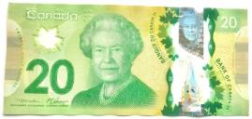






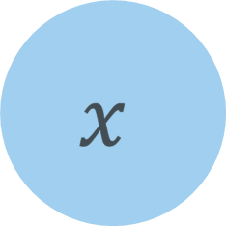
Good Guess
“You need a better prediction”
(Feedback)
Loss Function
(Performance)
$$x$$
w
$$\hat{y}$$
Weight
(guess)
Input
Prediction

Slide 14
Old w
Gradient Descent Algorithm
To make a better prediction, we need to adjust weight, based on the Loss Function.
The adjusted weight should have better prediction performance (or Loss Function).

Slide 15
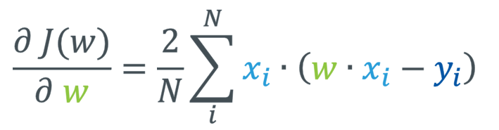
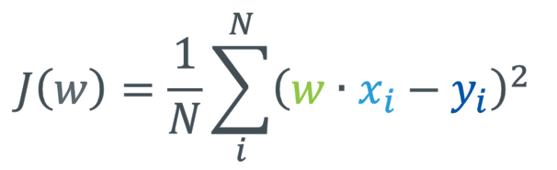
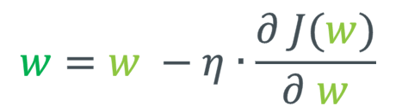
Gradient Descend Algorithm
We can calculate how Loss Function can be improved by adjusting weights.
Loss Function
Partial Derivative
The performance of the prediction
How much the performance improves by changing weight slightly.
$$J\left(w\right)=\frac{1}{N}\sum_{i}^{N}{{\left(w∙x_{i}−y_{i}\right)}^{2}}$$
$$\frac{∂ J(w)}{∂ w}=\frac{2}{N}\sum_{i}^{N}{x_{i}∙\left(w∙x_{i}−y_{i}\right)}$$
old weight
$$w=w −η∙\frac{∂ J(w)}{∂ w}$$
new weight
Learning parameter

Slide 16
Old w
Gradient Descent Algorithm (cont’d)
Now we have better guess of weight.
By repeating making prediction, calculating Loss Function, and improve weight, we can have better and better prediction.
New w

Slide 17

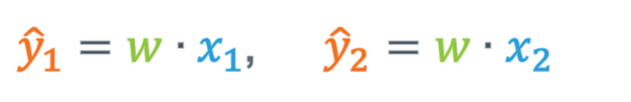


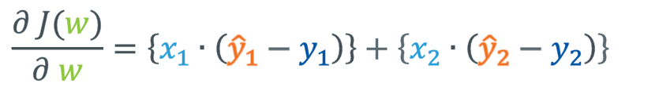
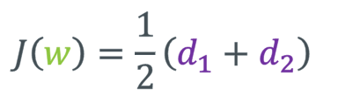
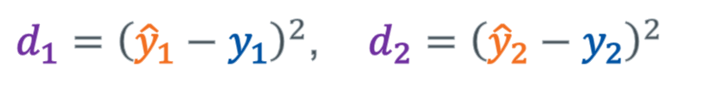
Hand Exercise
(1) Make a prediction
Let’s try one cycle by ourselves.
${\hat{y}}_{1}=w∙x_{1}$, ${\hat{y}}_{2}=w∙x_{2}$
“Calculate the new weight”
(2) The error of each prediction
Initial weight
$$w=1$$
$d_{1}={\left({\hat{y}}_{1}−y_{1}\right)}^{2}$, $d_{2}={\left({\hat{y}}_{2}−y_{2}\right)}^{2}$
Data Sets
(3) The Loss Function
Data | CAD (x) | EUR (y)
#1 | 40 (x1) | 20 (y1)
#2 | 50 (x2) | 30 (y2)
$$J\left(w\right)=\frac{1}{2}\left(d_{1}+d_{2}\right)$$
(4) Gradient
$$\frac{∂ J(w)}{∂ w}=\left\{x_{1}∙\left({\hat{y}}_{1}−y_{1}\right)\right\}+\left\{x_{2}∙\left({\hat{y}}_{2}−y_{2}\right)\right\}$$
Learning rate$(η=0.0001)$
(5) New Weight
$$w=w −η∙\frac{∂ J(w)}{∂ w}$$

Slide 18
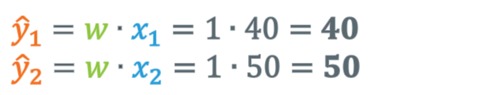
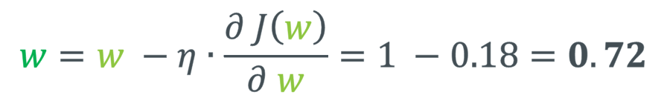
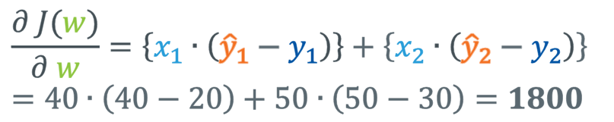
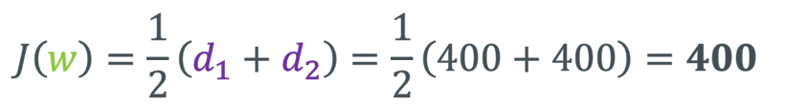
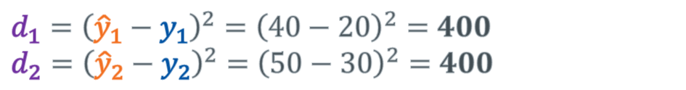
Answer
(1) Make a prediction
${\hat{y}}_{1}=w∙x_{1}=1∙40=40$ $${\hat{y}}_{2}=w∙x_{2}=1∙50=50$$
“Calculate the new weight”
(2) The error of each prediction
Initial weight
$$w=1$$
$$d_{1}={\left({\hat{y}}_{1}−y_{1}\right)}^{2}={\left(40−20\right)}^{2}=400 \\ d_{2}={\left({\hat{y}}_{2}−y_{2}\right)}^{2}={\left(50−30\right)}^{2}=400$$
(3) The Loss Function
Data Sets
$$J\left(w\right)=\frac{1}{2}\left(d_{1}+d_{2}\right)=\frac{1}{2}\left(400+400\right)=400$$
Data | CAD (x) | EUR (y)
#1 | 40 (x1) | 20 (y1)
#2 | 50 (x2) | 30 (y2)
(4) Gradient
$$\frac{∂ J(w)}{∂ w}=\left\{x_{1}∙\left({\hat{y}}_{1}−y_{1}\right)\right\}+\left\{x_{2}∙\left({\hat{y}}_{2}−y_{2}\right)\right\} \\ =40∙\left(40−20\right)+50∙\left(50−30\right)=1800$$
Learning rate$(η=0.0001)$
(5) New Weight
$$w=w −η∙\frac{∂ J\left(w\right)}{∂ w}=1 −0.18=0.72$$

Slide 19



$$w=1$$
Data | CAD (x) | EUR (y)
#1 | 40 | 20
#2 | 50 | 30
$$w=0.72$$
$$w=0.65$$
Step | W | J(w)
#1 | 1.0 | 400
#2 | 0.72 | 56.72
#3 | 0.65 | 45.85

Slide 20
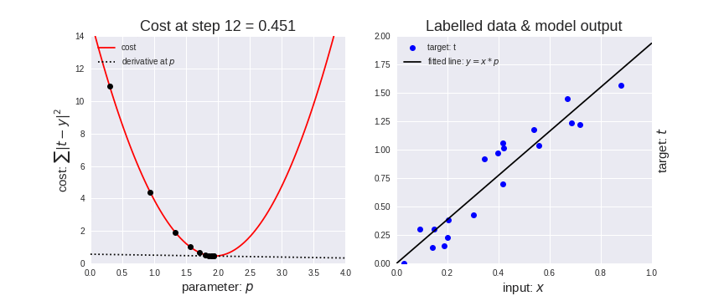

Slide 21
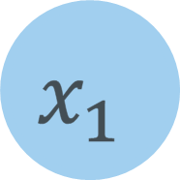
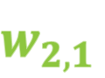

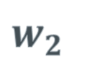
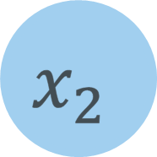

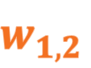



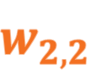
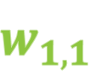



More Complexity for Complex Problems
→ More nodes, more links and more calculations
2 x 1 Node
2 x 2 Node
$$x_{1}$$
$$w_{1,1}$$
$$y_{1}$$
$$x_{1}$$
$$w_{1}$$
$$y$$
$$w_{2,1}$$
$$w_{1,2}$$
$$x_{2}$$
$$w_{2,2}$$
$$y_{2}$$
$$x_{2}$$
$$w_{2}$$
$$y_{1}=\left(w_{1,1}∙x_{1}\right)+\left(w_{2,1}∙x_{2}\right)$$
$$y_{2}=\left(w_{1,2}∙x_{1}\right)+\left(w_{2,2}∙x_{2}\right)$$
$$y=\left(w_{1}∙x_{1}\right)+(w_{2}∙x_{2})$$

Slide 22
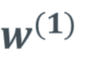
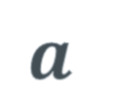


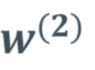

More Complexity for Complex Problems
Hidden Layer & Activation Function
$$x$$
$$y$$
$$w^{(1)}$$
$$w^{(2)}$$
$$z$$
$$a$$
Input
Hidden Layer
Output
$$a=g\left(z\right)$$
z: output of 1st layer
g: activation function

Slide 23
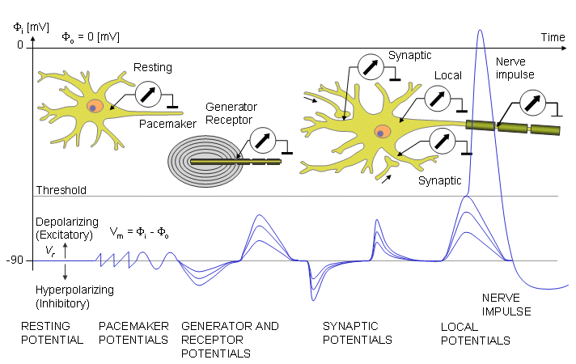
What is Activation Function
Threshold Potential in Neural Cell
The cell does not activate until the input signal reaches certain strength, or threshold.

Slide 24

What is Activation Function
To duplicate the Threshold Potential, we introduce activation function.

Slide 25

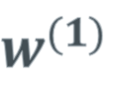
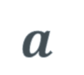
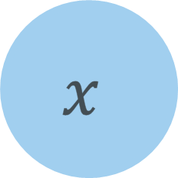

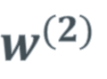



Multiple Layer Training Session
Forward Propagation
$$z=w^{(1)}∙x$$
$$y=w^{(2)}∙a$$
$$a=g(z)$$
$$x$$
$$y$$
$$w^{(1)}$$
$$w^{(2)}$$
$$z$$
$$a$$

Slide 26







Multiple Layer Training Session
Backward Propagation
$$x$$
$$y$$
$$w^{(1)}$$
$$w^{(2)}$$
$$z$$
$$a$$
$$\frac{∂J(w)}{∂w^{(1)}}=\frac{∂J(w)}{∂y}∙\frac{∂y}{∂a}∙\frac{∂a}{∂z}∙\frac{∂z}{∂w^{(1)}}$$

Slide 27
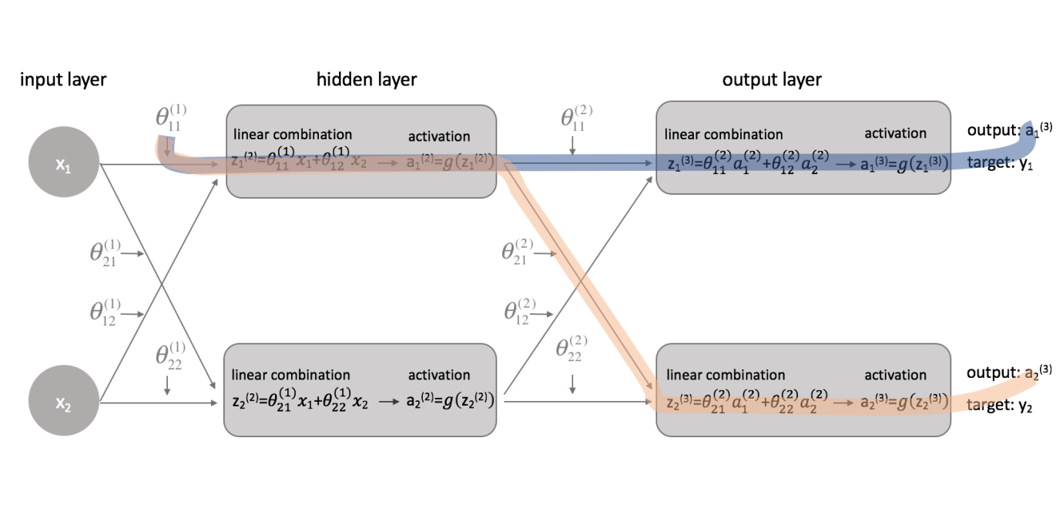
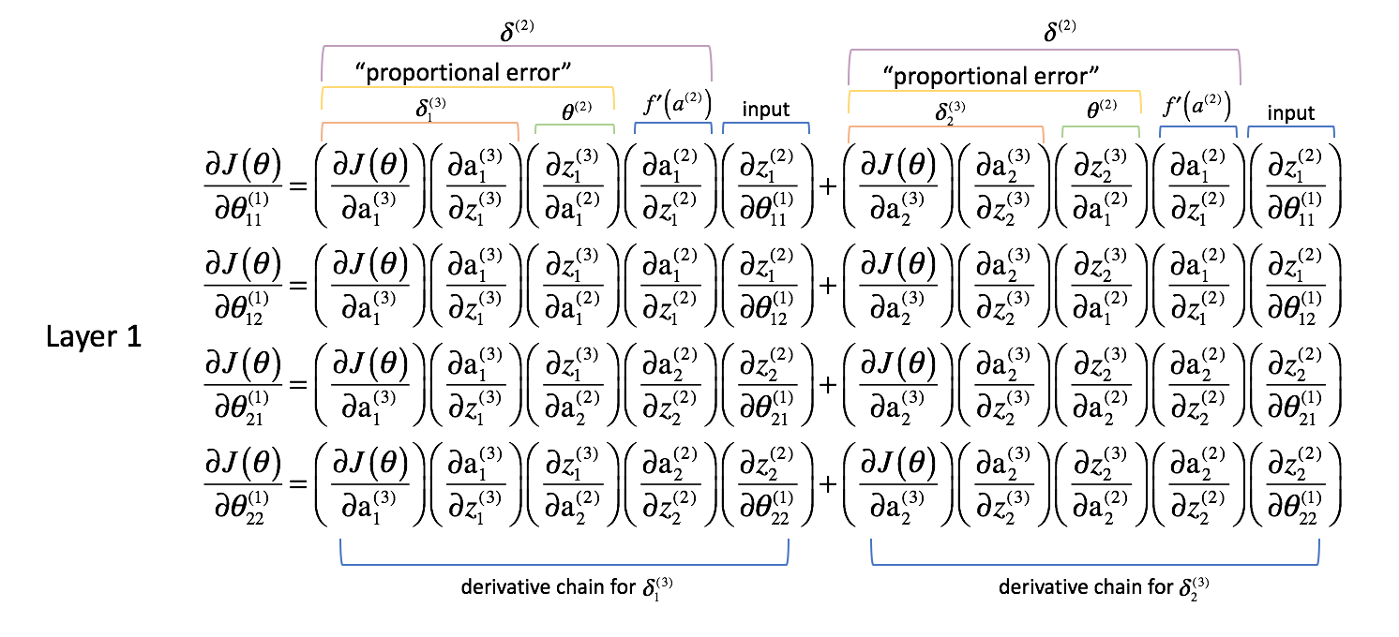
The more complex the model is, the more expensive* to calculate!

Slide 28
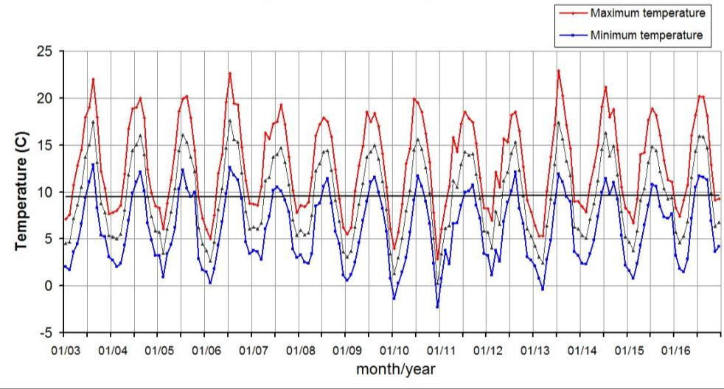
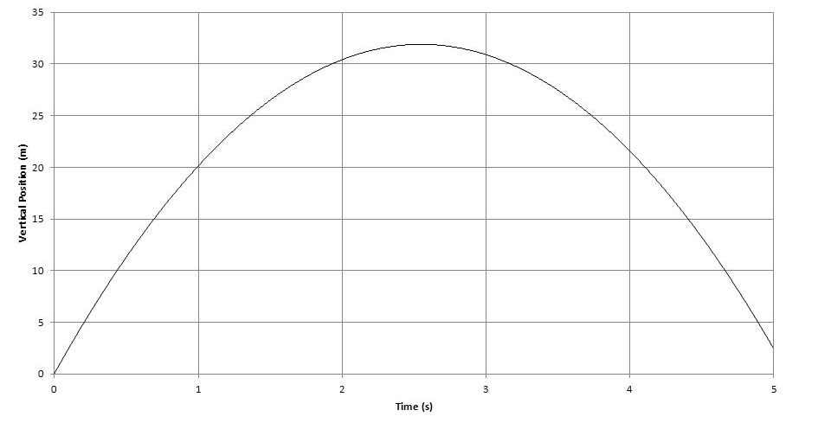
But Why Use Hidden Layer
→ Because not all problems are linear (The world is complex!)
Parabolic: Throwing a ball
Periodic: Monthly Temperature

Slide 29
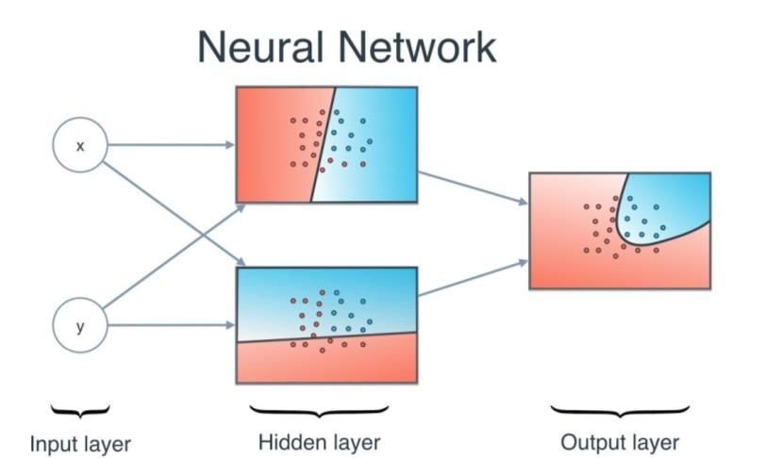

But Why Use Hidden Layer
→ Combining Linear to Break Linearity Problem

Slide 30


Slide 31

The Key is Complex Network
→ Complex Model Can Capture the Complex Pattern

Slide 32



Side Effects of Complexity
→ Neural Network has expensive calculation cost.

Slide 33

Side Effects of Complexity
→ The Black Box Problem

Slide 34


Slide 35


Advanced Neural Network Model
→ Stacking More Layers
CNN: Convolution Neural Network
RNN: Recurrent Neural Network
Image, Speech and Text Recognition
Specialized in Sequential Data

Slide 36

Advanced Neural Network Model

Slide 37
Q & A

